Slide 1
IBM Applied Data Science
Capstone Course
Analyzing the impact of Parks on the Pollution Levels
of Delhi, India
By:-
Harshit Agarwal
April, 2020

Slide 2
Business Problem
The main objective of this project is to analyze the amount or frequencies of Parks in different regions of Delhi.
Delhi being one of the most polluted city, has many reasons for its pollution level to rise. Industries, emission of Carbon mono oxides from vehicles as well as Badarpur Thermal Power Station, overpopulation, and specially increased levels of pollution in the time of Diwali Festival when excess of firecrackers are burnt.
Using this study we can create more parks in the regions where there is very low number of parks. This would definitely help to curb pollution to some extent.

Slide 3
Data Source
List of Neighborhoods in Delhi, India. This data is provided from Wikipedia site: https://en.wikipedia.org/wiki/Neighbourhoods_of_Delhi . It contains all the regions that comprises inside Delhi which sums up to 187 in number. This is the scope of the project all the data is relevant to these regions only.
The Latitude and Longitude data of the neighborhood in Delhi. The geocoder library of python is used in order to fetch the coordinates of neighborhood in Delhi.
The nearby Venues to all the Neighborhood's in Delhi. The Foursquare API is used in order to fetch 100 venues in the radius of 2000m of every neighborhood in Delhi.

Slide 4
Methodology
The Data Gathering :- Gather all the data from the Data Sources we have and place it into the respective data frames .
The Analyzing of Data :- Analysis starts with one hot encoding of the data we have. We provide Boolean values to the venues respective to their areas. The value 1 is given to the present venues and 0 to the non-present venues in the neighborhoods.
The Clustering of Data :- We are all set to cluster the data and see the outcomes. The data is clustered into 5 sets. K-means clustering algorithm is used to cluster the data into 5 sets. The Cluster labels from 0 to 4 would be applied on the data .

Slide 5
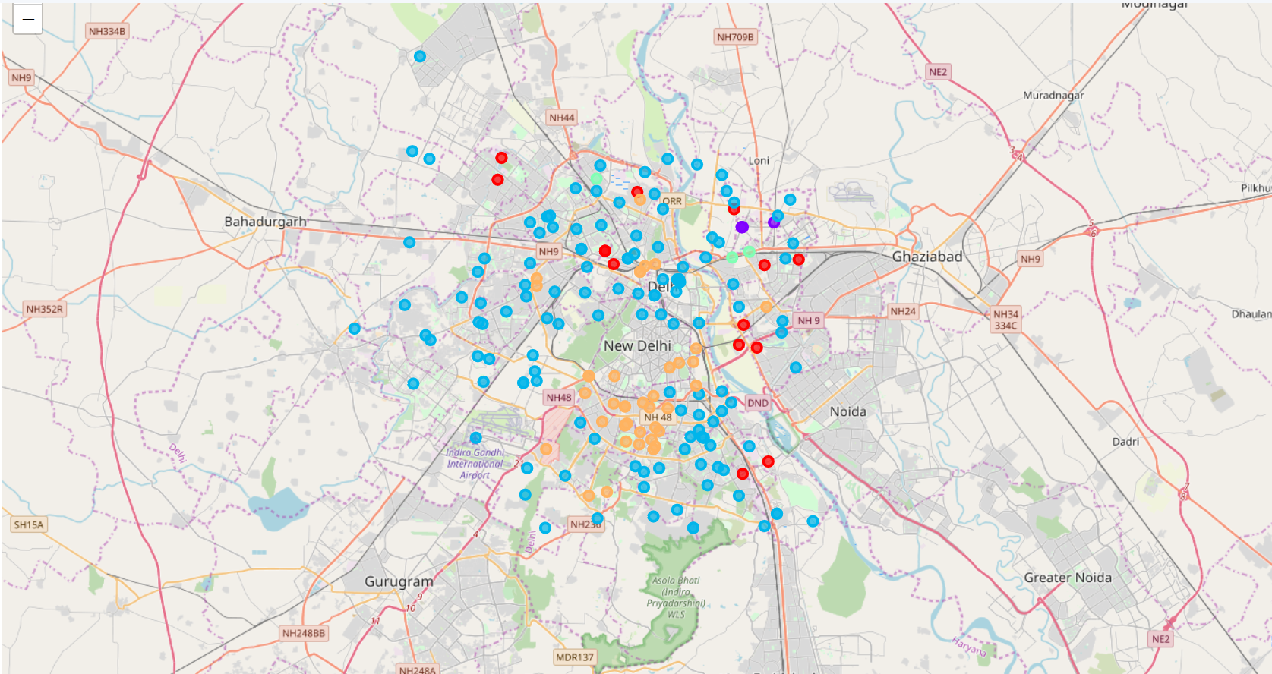
Results
The results of the K-means clustering shows that we have our data clustered into 5 sets based on the frequencies of the occurrence of the Parks.
• Cluster 0 : Consists of average level park frequencies.
• Cluster 1 : Best cluster as it shows park frequencies from 0.4 – 0.5.
• Cluster 2 : This is the cluster with vast number of neighborhoods in it and least level of park frequencies ranging from 0.00 – 0.01.
• Cluster 3 : Consists of above average park frequencies.
• Cluster 4 : Consists of below average park frequencies.

Slide 6
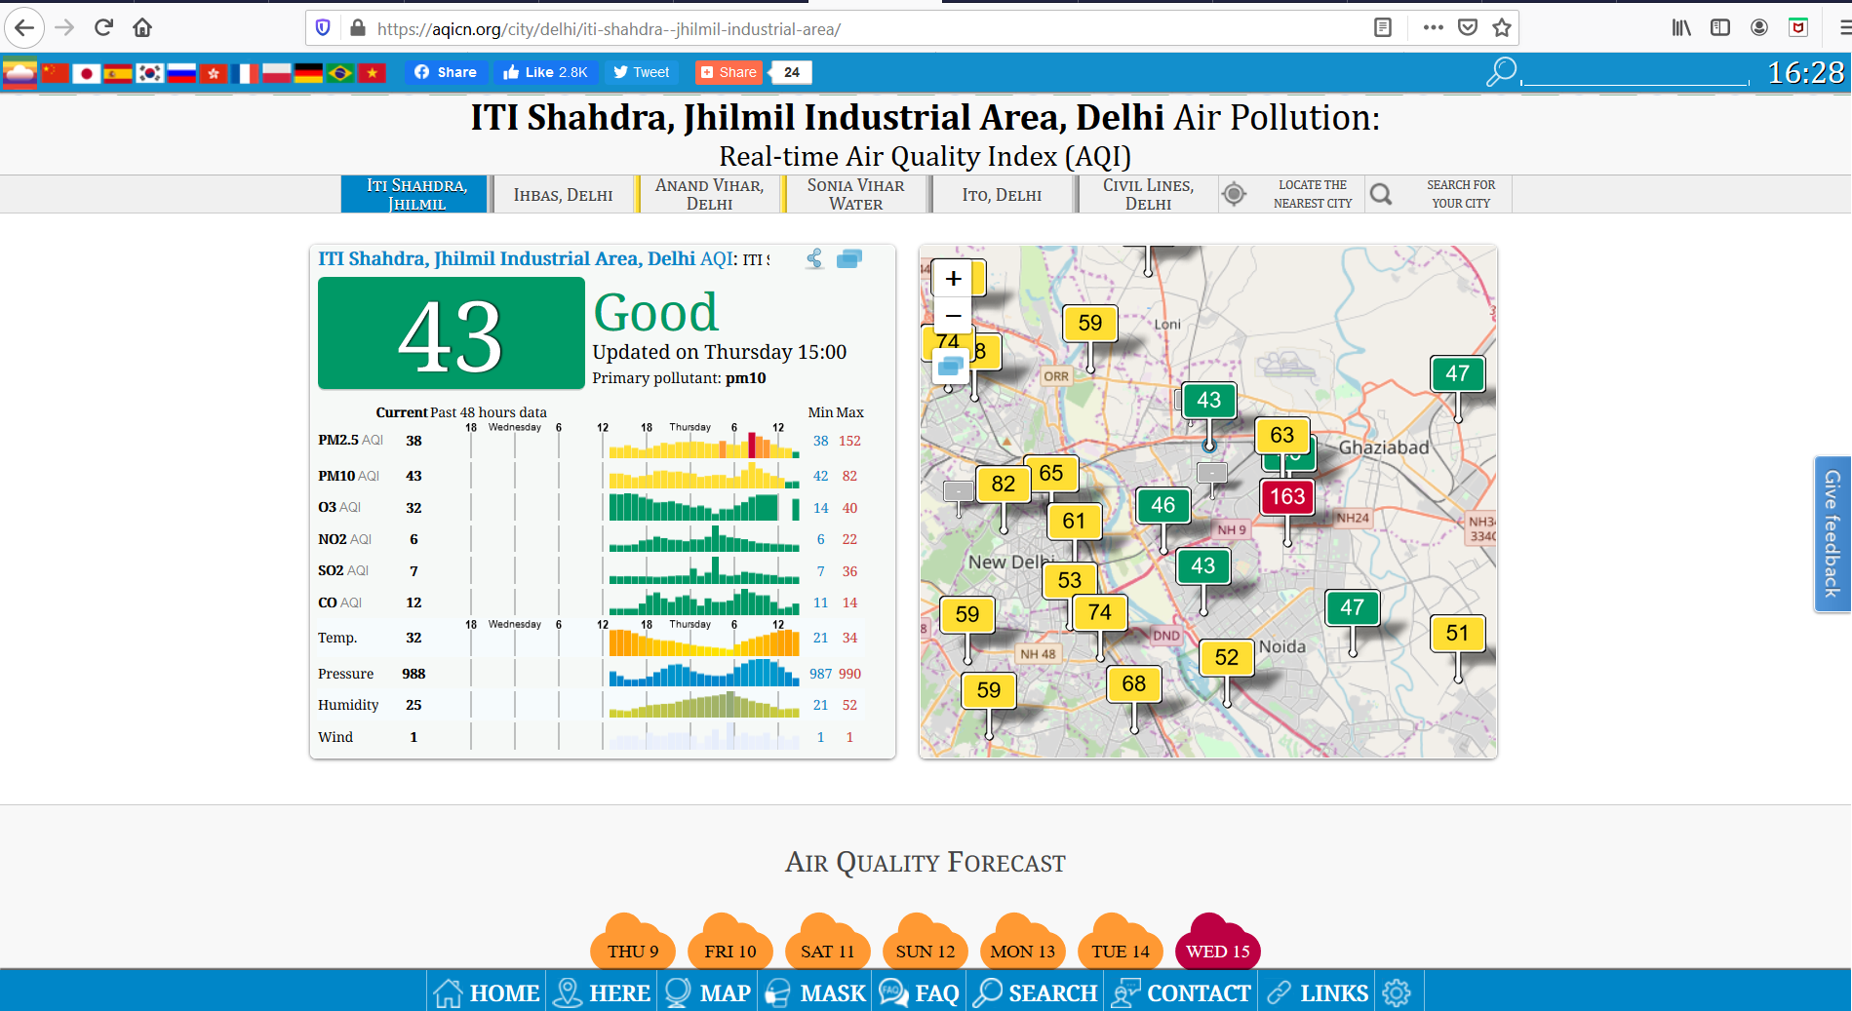
Classified in
Cluster 1

Slide 7
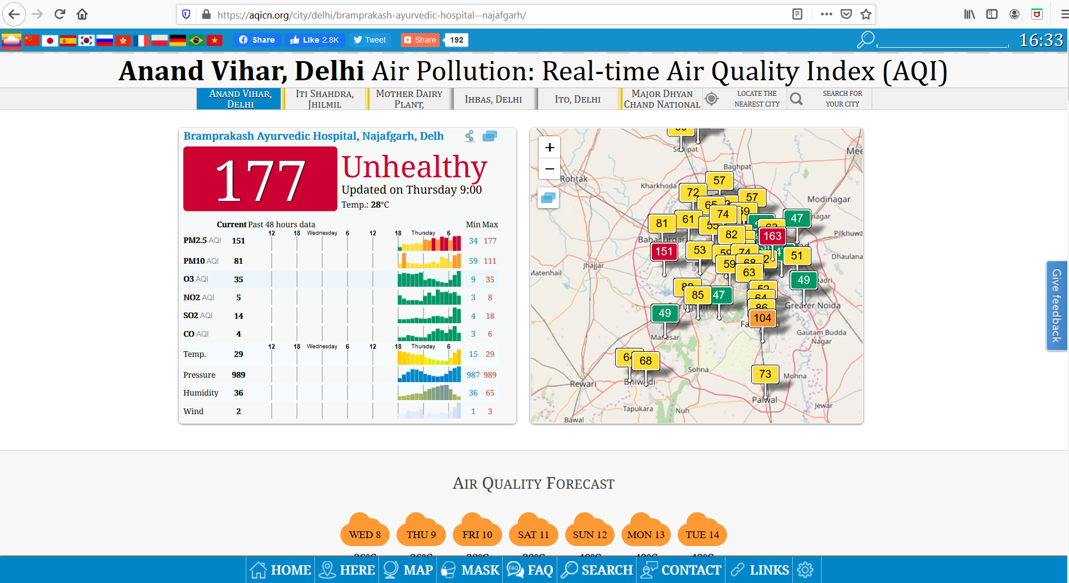
Classified in
Cluster 2

Slide 8
5 Clusters

Slide 9
Discussions
If we create a diagonal symmetrical line passing from the center of the New Delhi from Northwest to Southeast, we can see Delhi in 2 halves where the upper half is concentrated with more parks and the lower half as very low amount of parks.
On the map, the red dots , violet dots, green dots are all on the upper half. Which means, average and above average park frequencies are all located in the upper half of Delhi and on the lower half is the below average and least concentrated park frequencies.
So to maintain a balance in the air pollution levels in Delhi as a whole, the organizations can start creating parks from the lower half of the Delhi.

Slide 10
Conclusion
The conclusion of the project is, Cluster number 2 with least amount of park frequencies are more vulnerable to severe air pollution.
Whereas in comparison to Cluster number 1, Cluster 1 shows better air quality standards.
There were 5 sets of clusters which defined the park frequency as best, above average, average, below average, least. Cluster 1 was the best, 3 was above average, 0 was averaged, 4 was below average and cluster 2 had the least amount of park frequencies.
Creating more greenery can be started from the lower half of Delhi which has low amount parks in it. Therefore targeted approach towards the goal gives getter outcome always.

Slide 11
Thank
You !!

